Slide 1
PET NEST
- A Pet Service Website
By
Naga devika kongala (8097413)
Sairam pothem (8097420)
Srinivasulu rajupalem (8097424)
Vinod kumar veeravalli (8097402)

Slide 2
CONTENTS
Objective
Wireframe of Website
Project Details

Slide 3
OBJECTIVE
To create a responsive pet service website using Bootstrap-4.

Slide 4
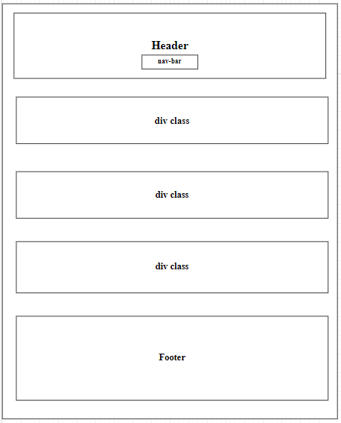
WIREFRAME

Slide 5

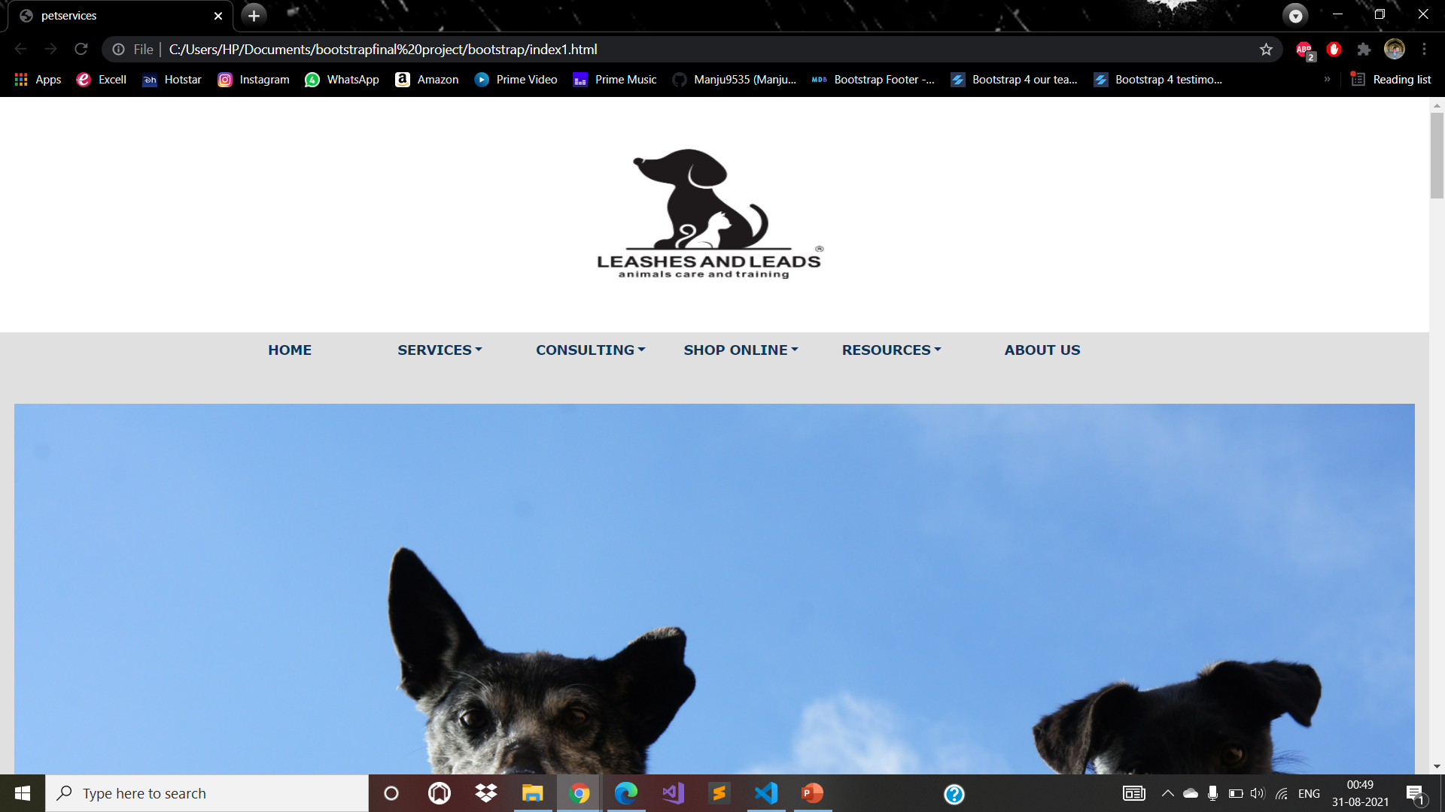
HOME PAGE

Slide 6
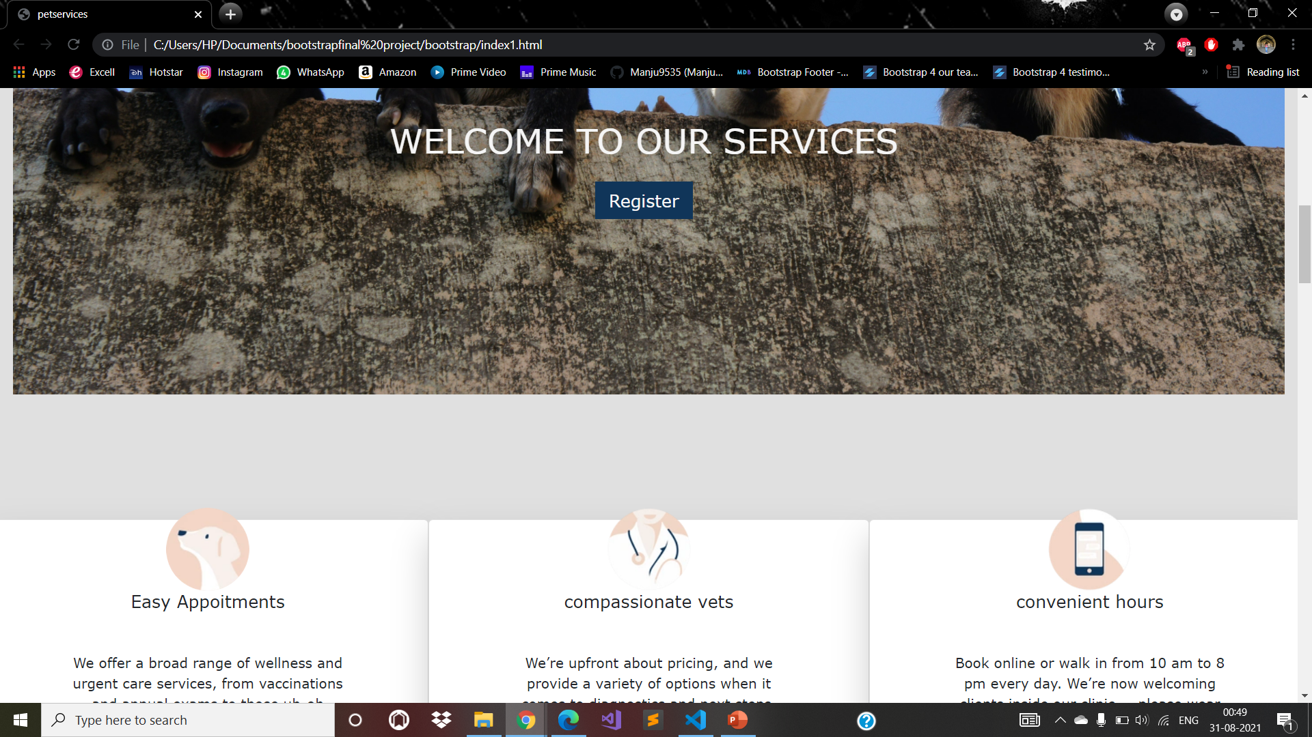
HOME

Slide 7
HOME

Slide 8
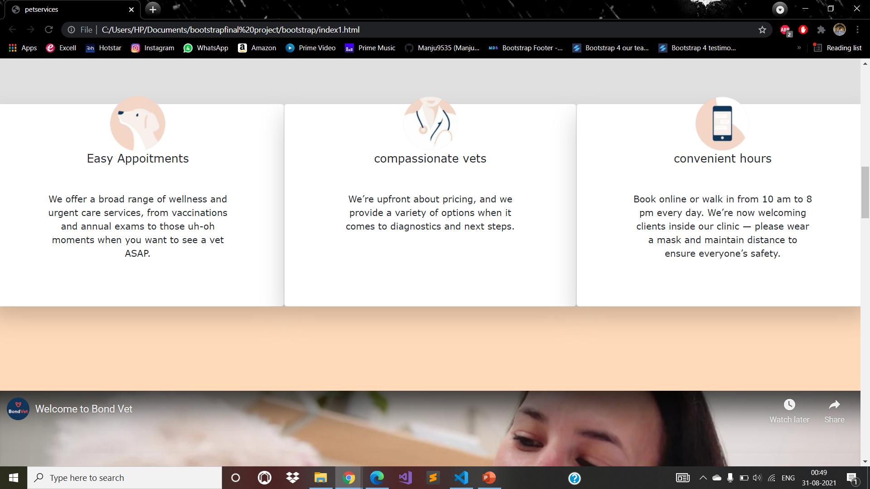
HOME

Slide 9
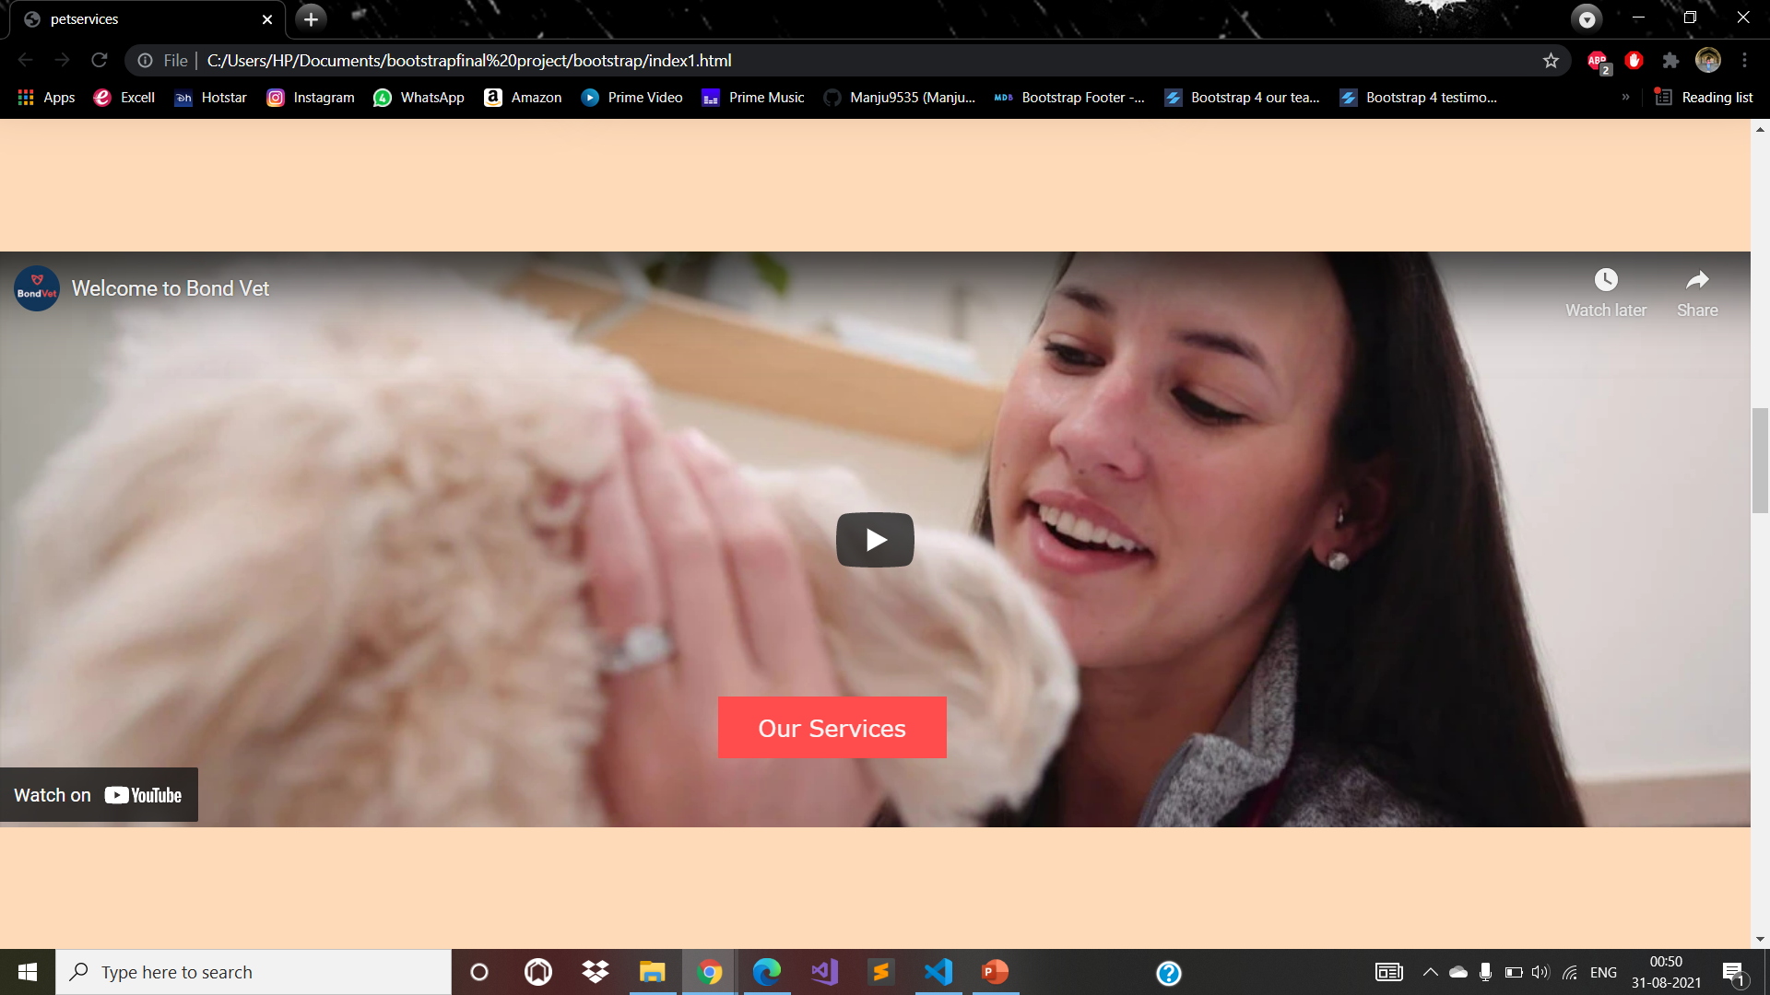
HOME

Slide 10
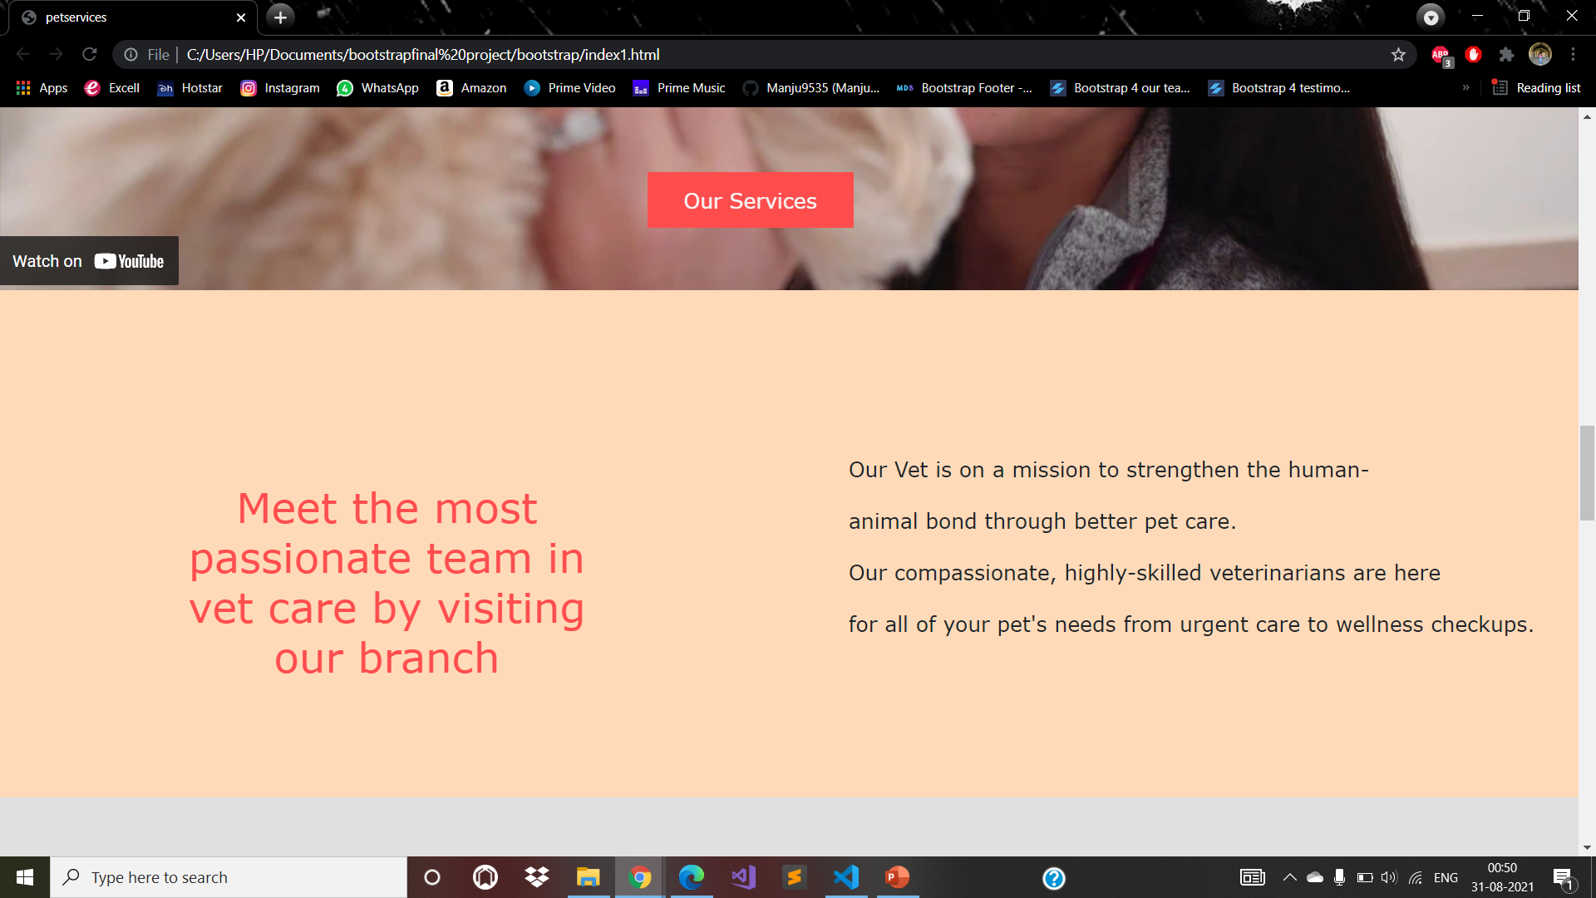
HOME

Slide 11
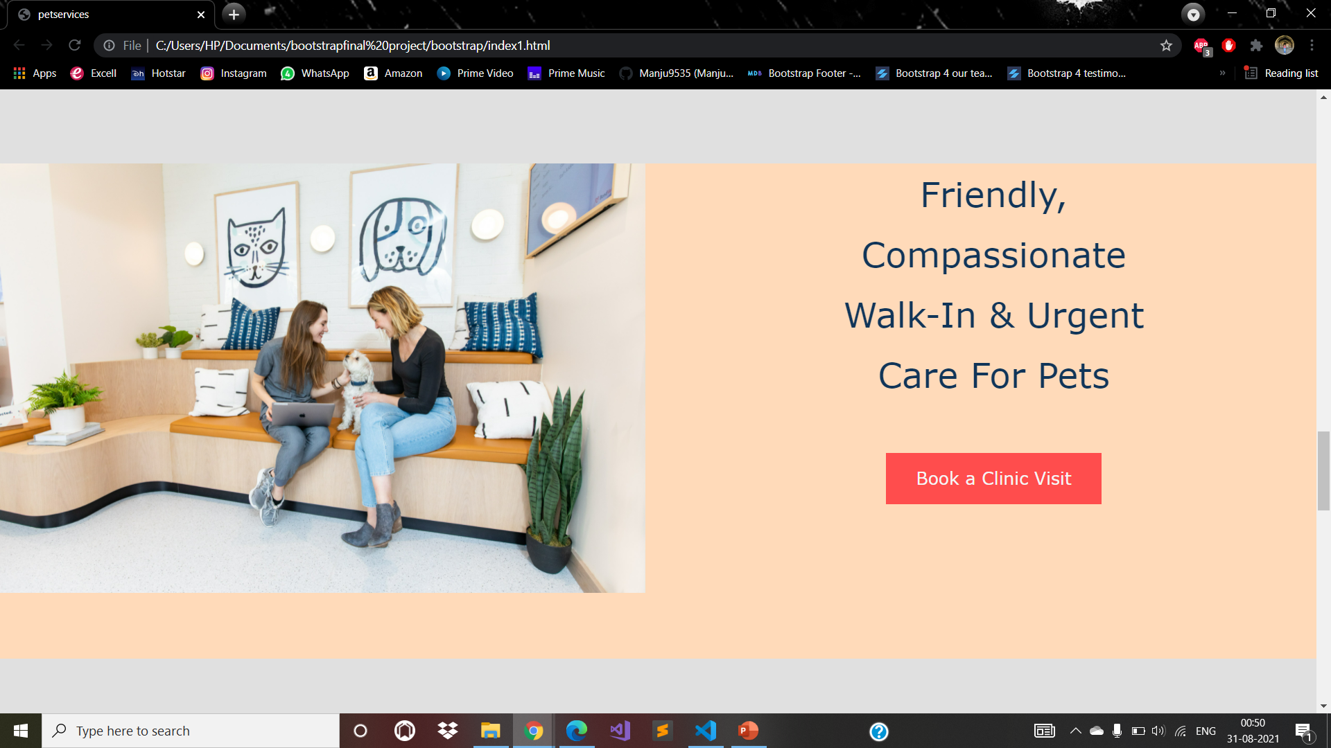
HOME

Slide 12
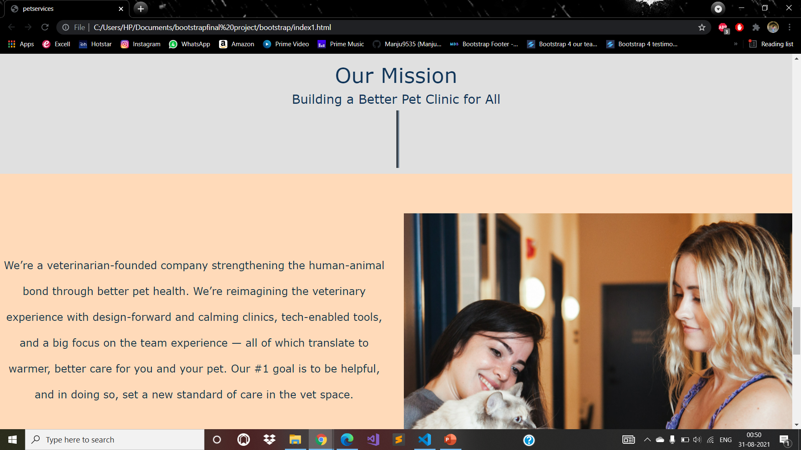
HOME

Slide 13
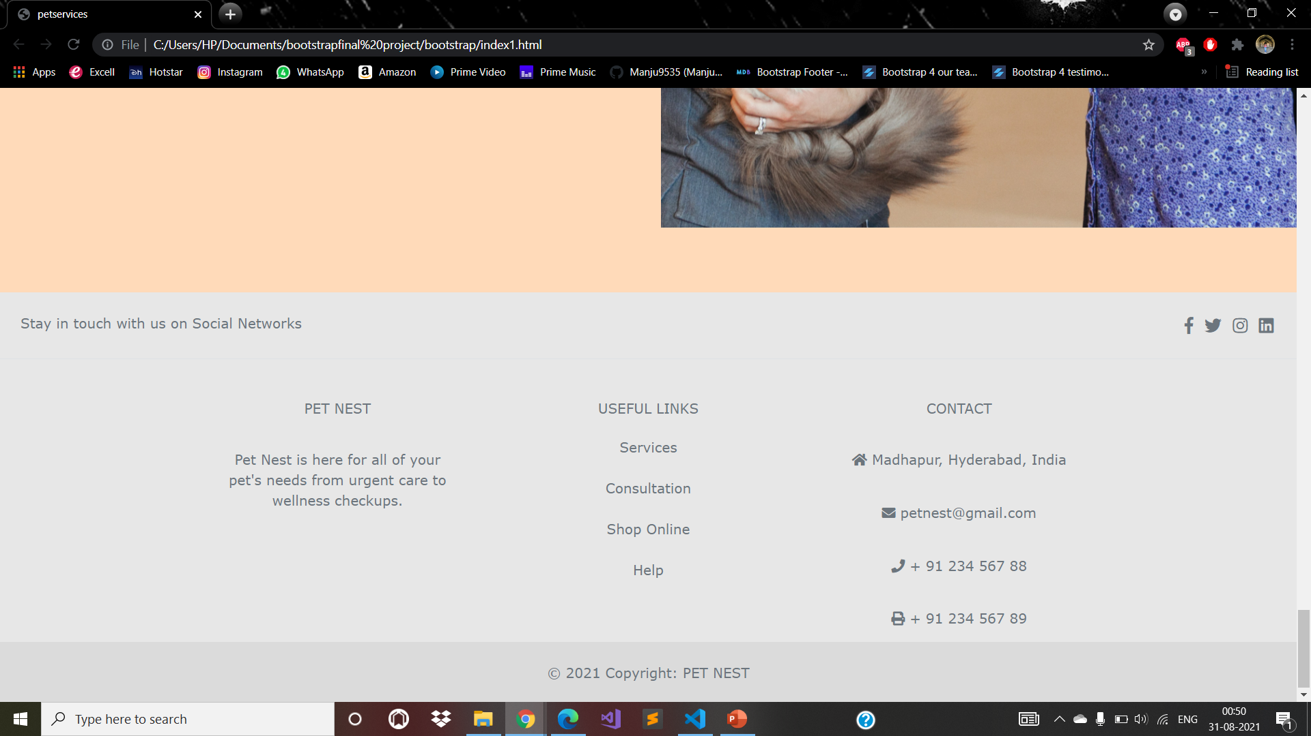
HOME

Slide 14

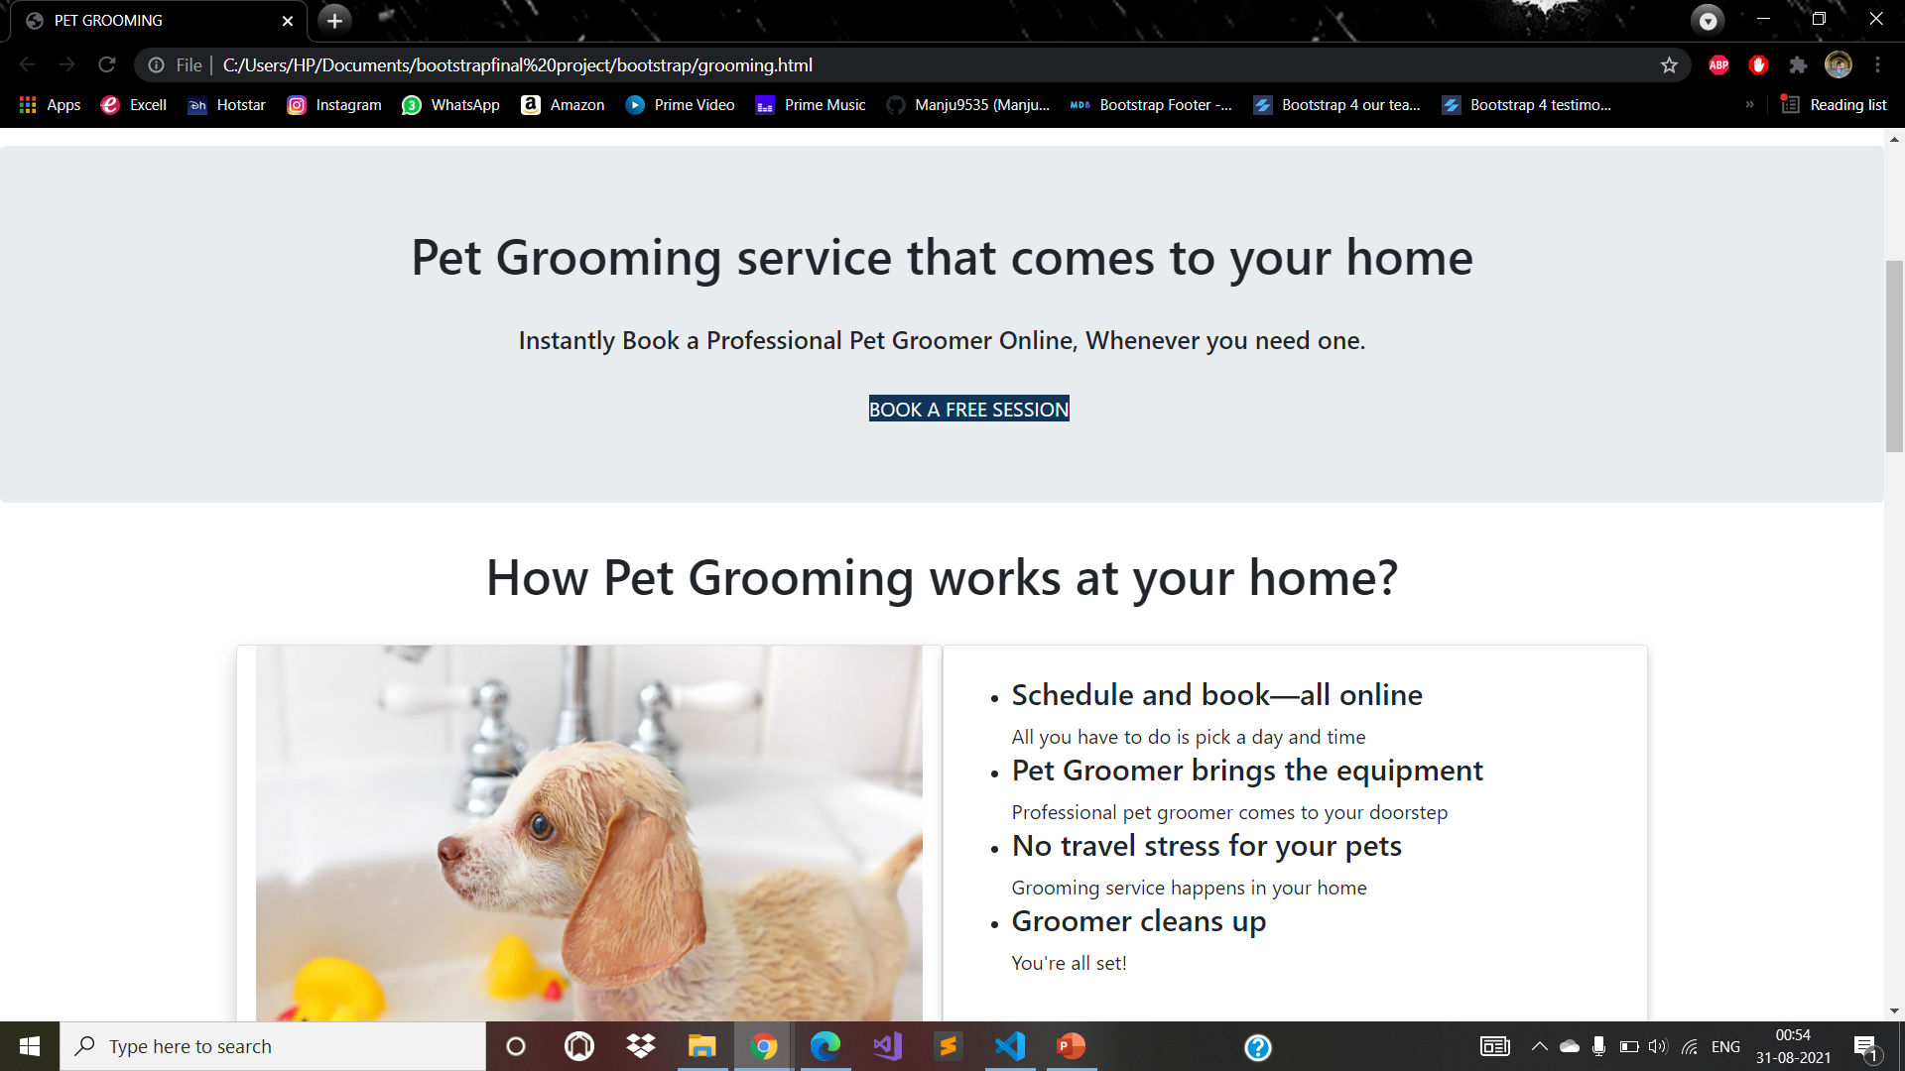
GROOMING

Slide 15
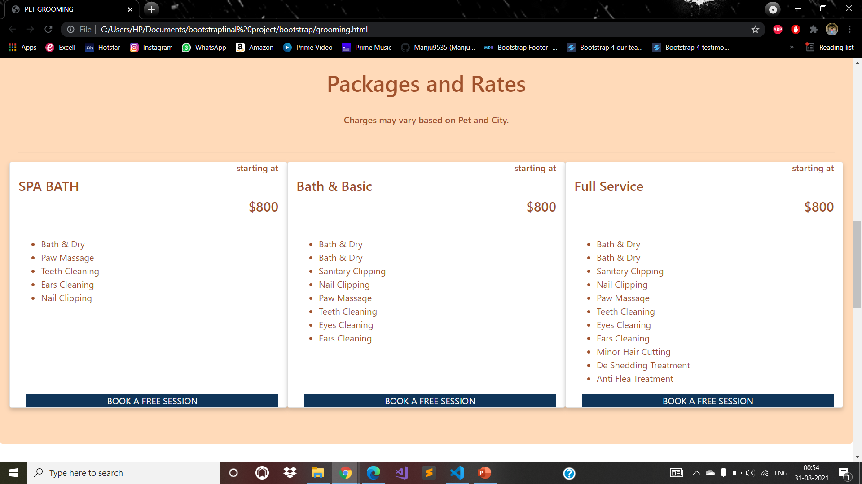
GROOMING

Slide 16
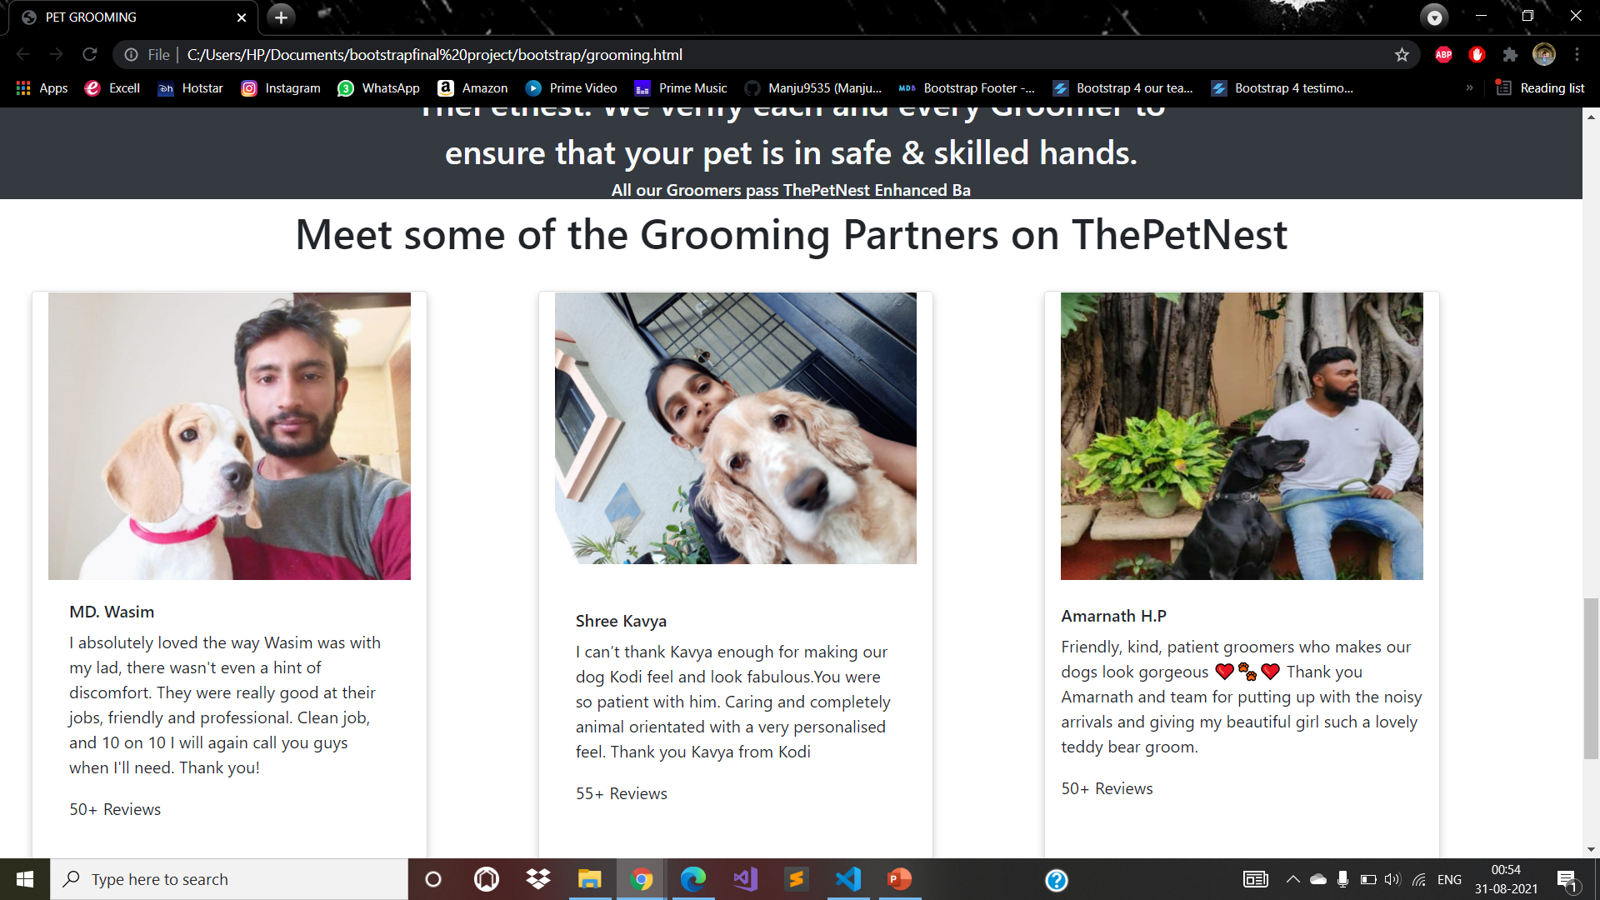
GROOMING

Slide 17
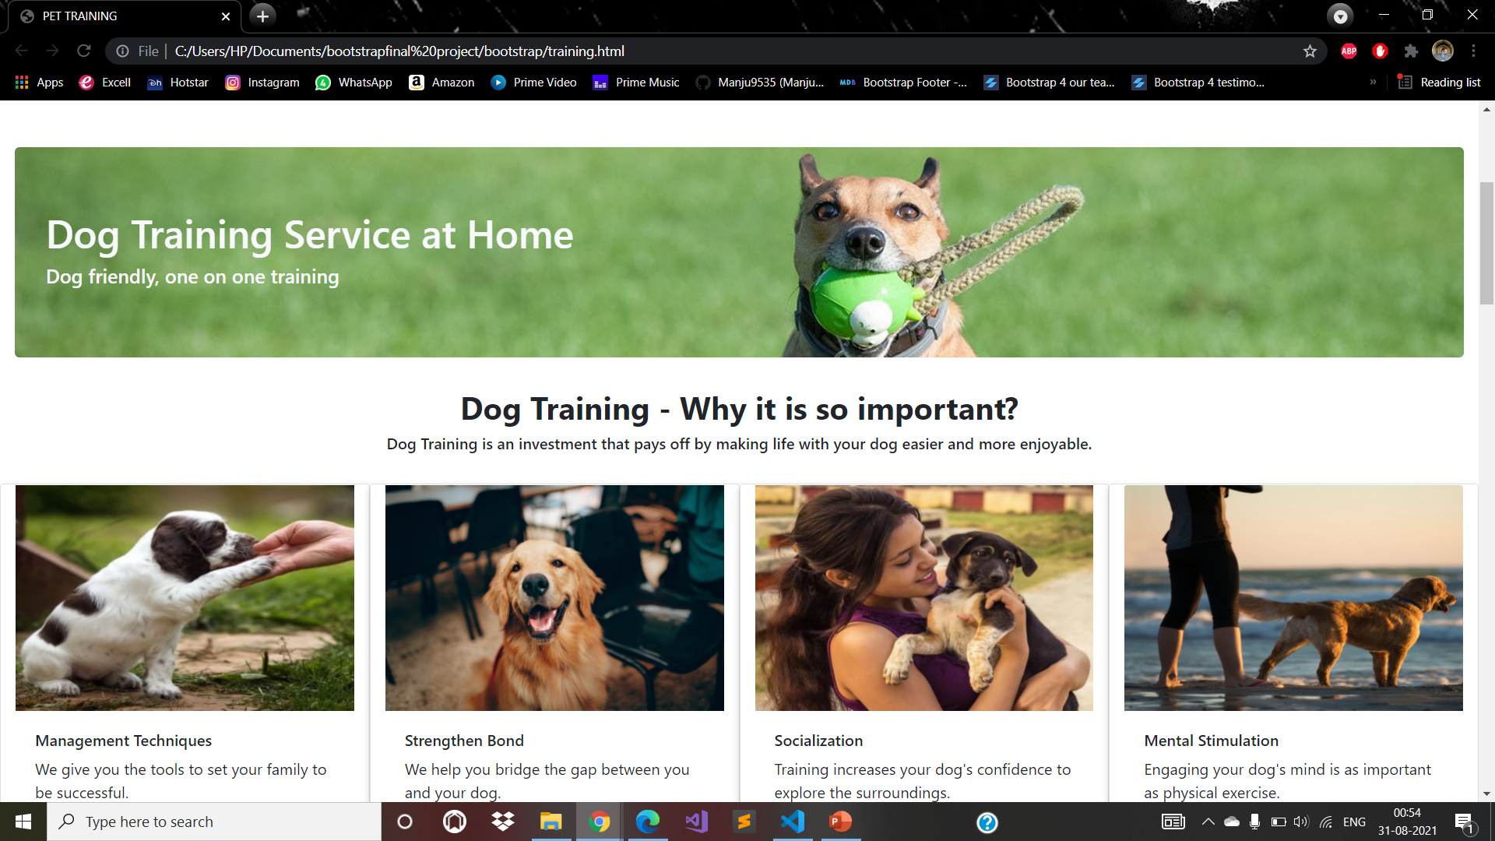
TRAINING

Slide 18
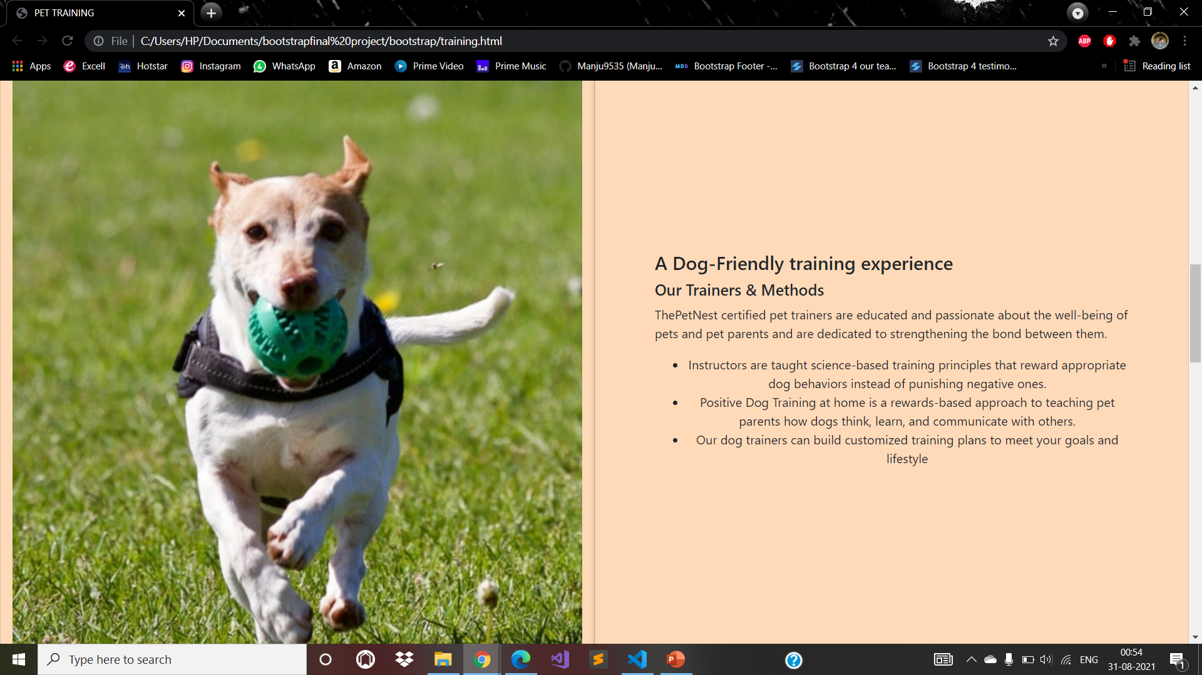
TRAINING

Slide 19
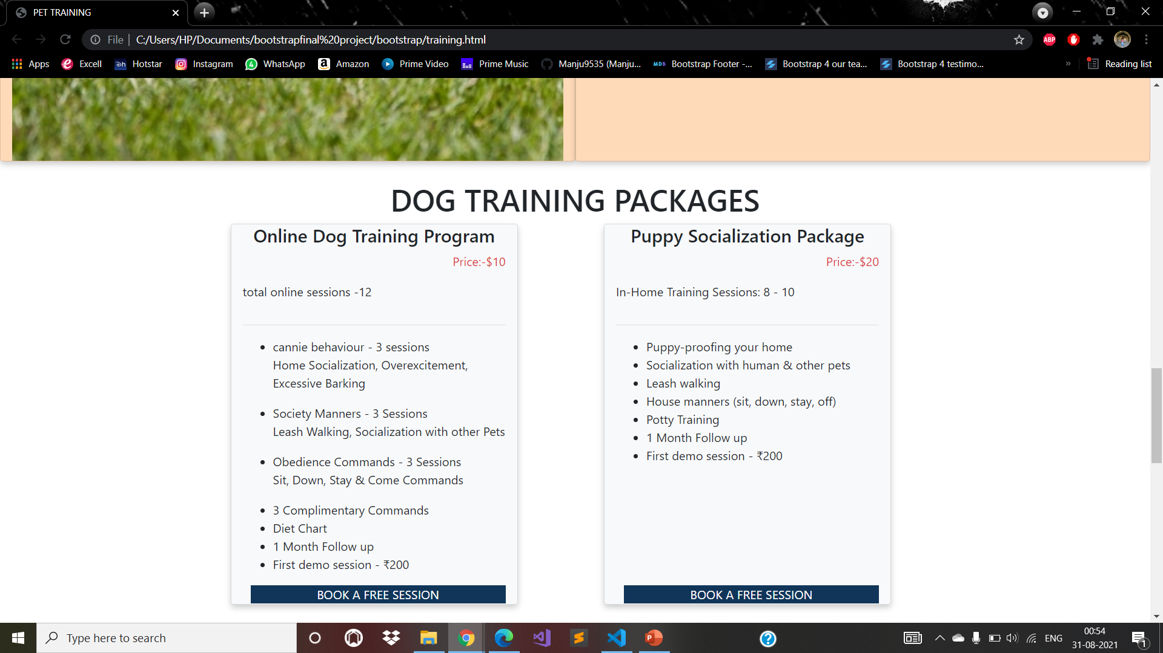
TRAINING

Slide 20
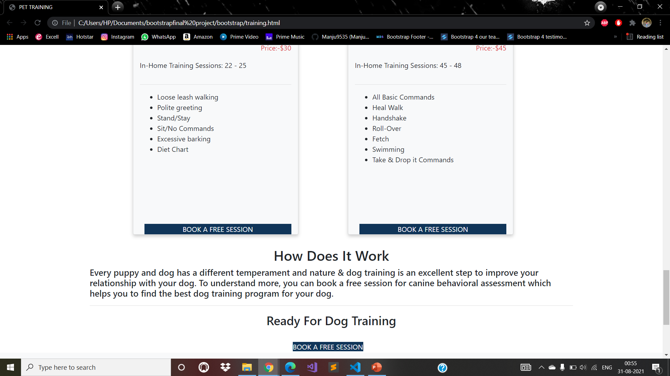
TRAINING

Slide 21
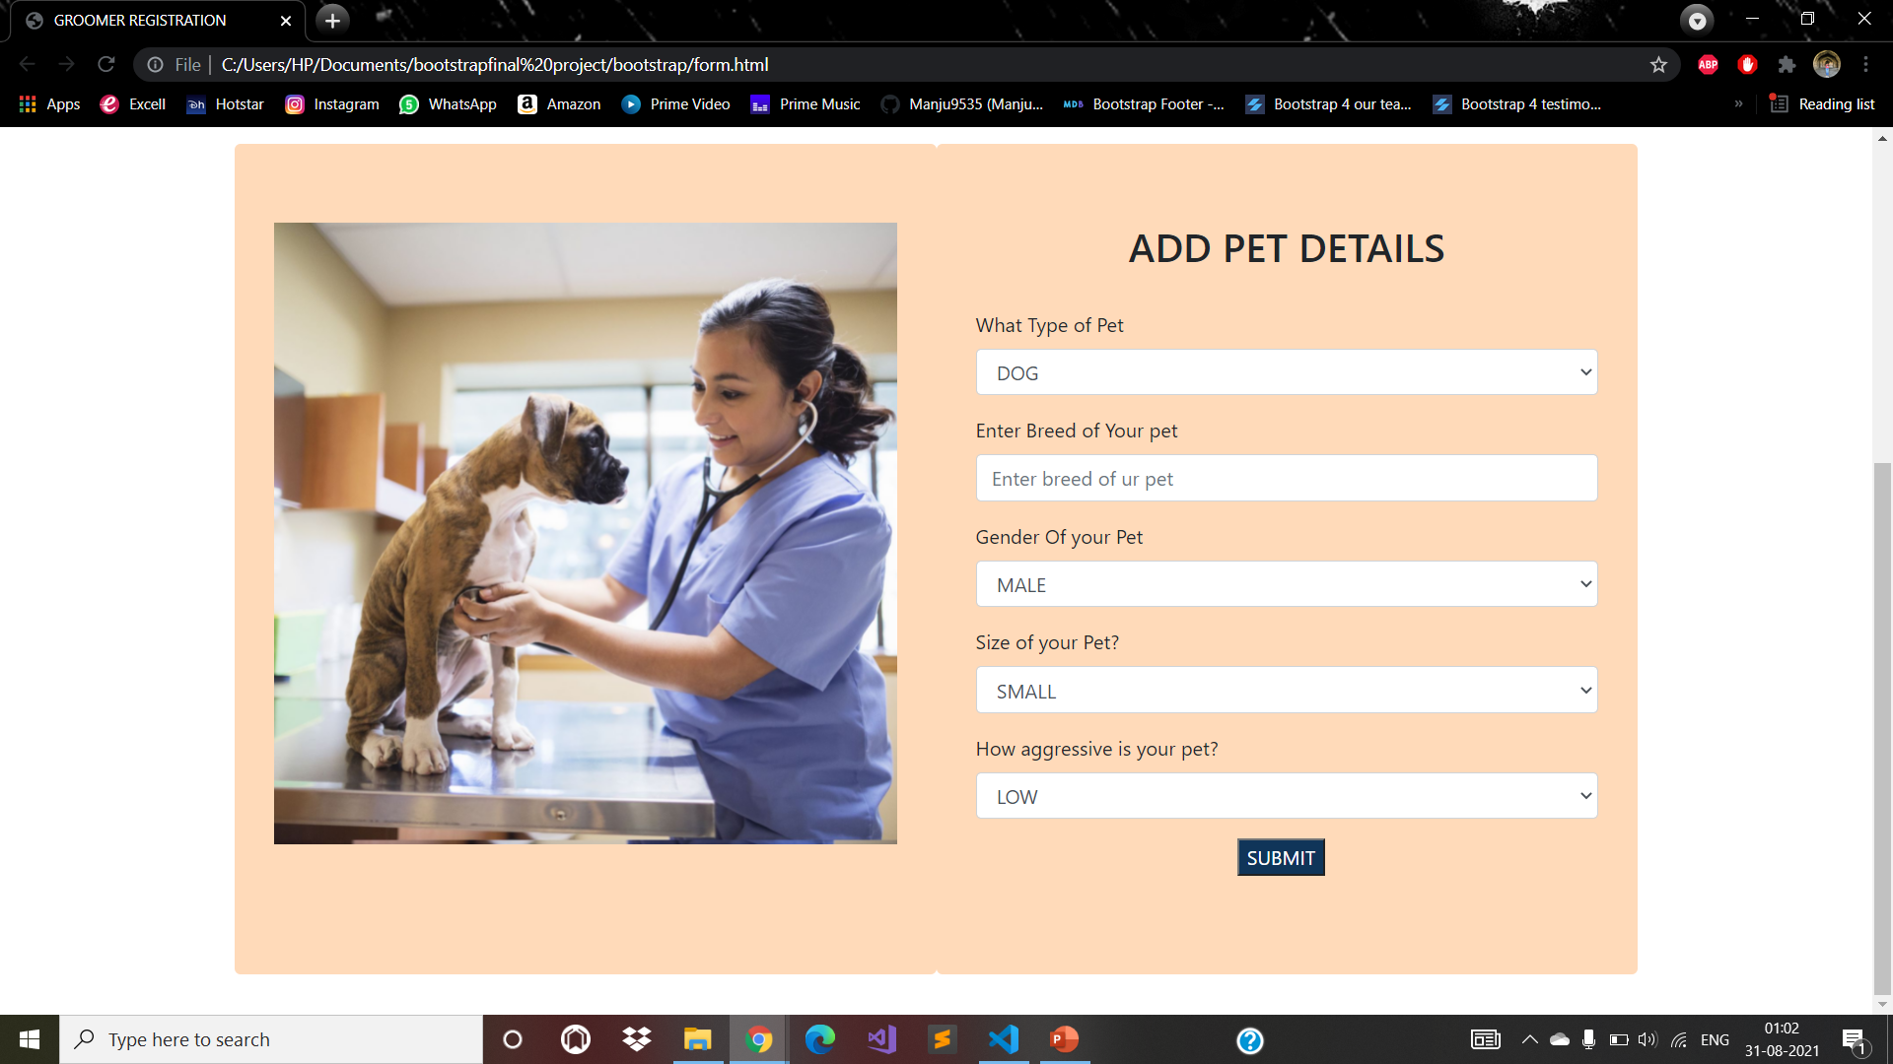
PET DETAILS FORM

Slide 22
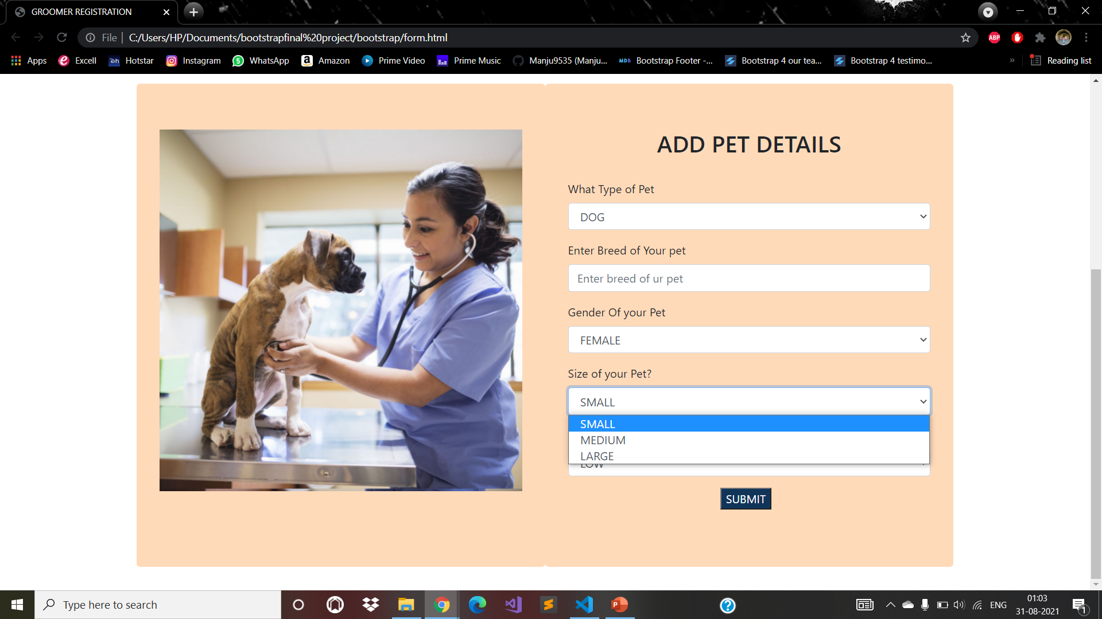
PET DETAILS FORM

Slide 23

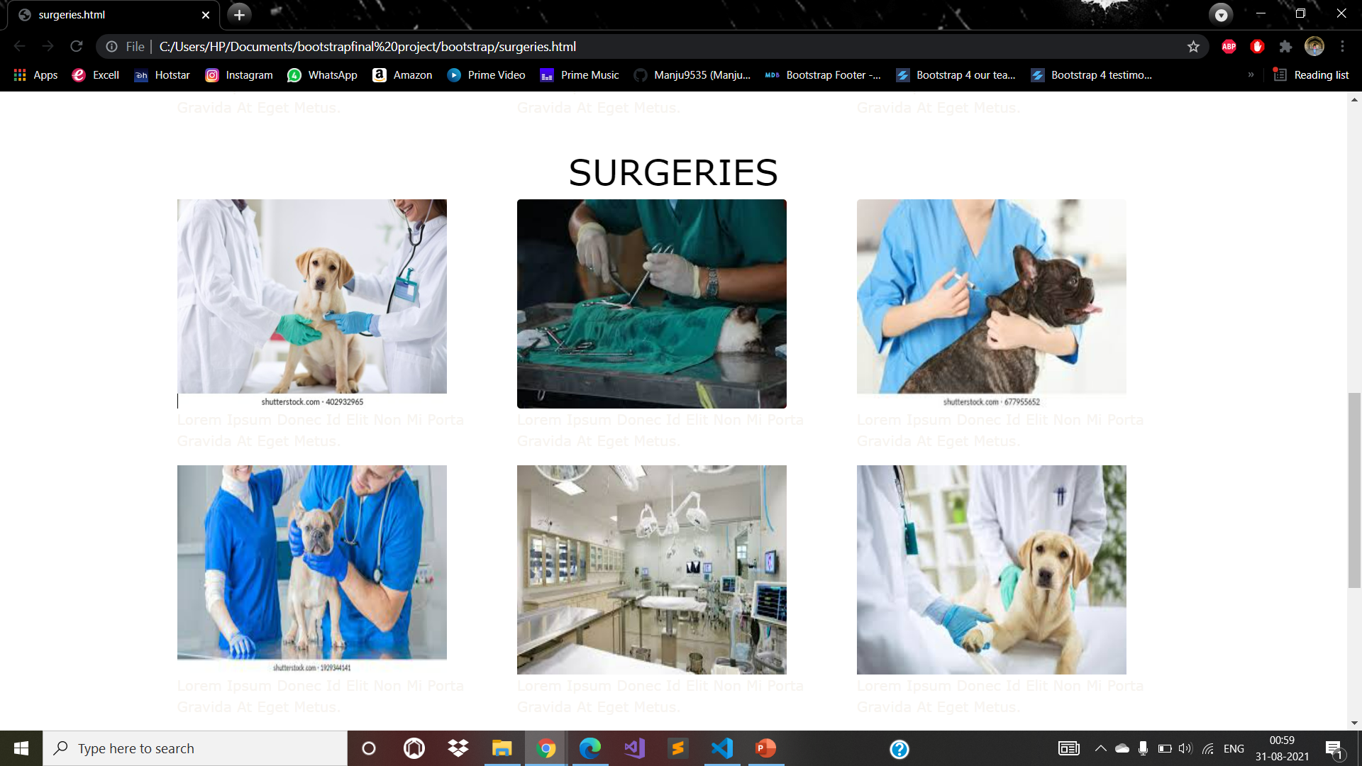
SERVICES

Slide 24
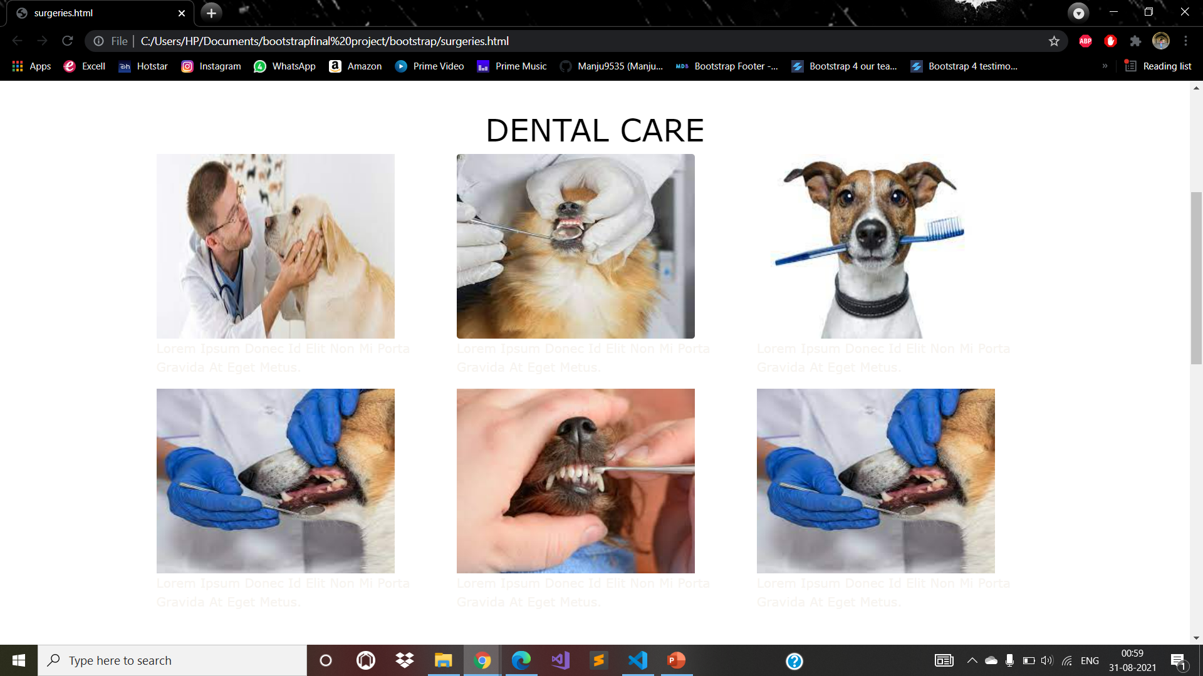
SERVICES

Slide 25
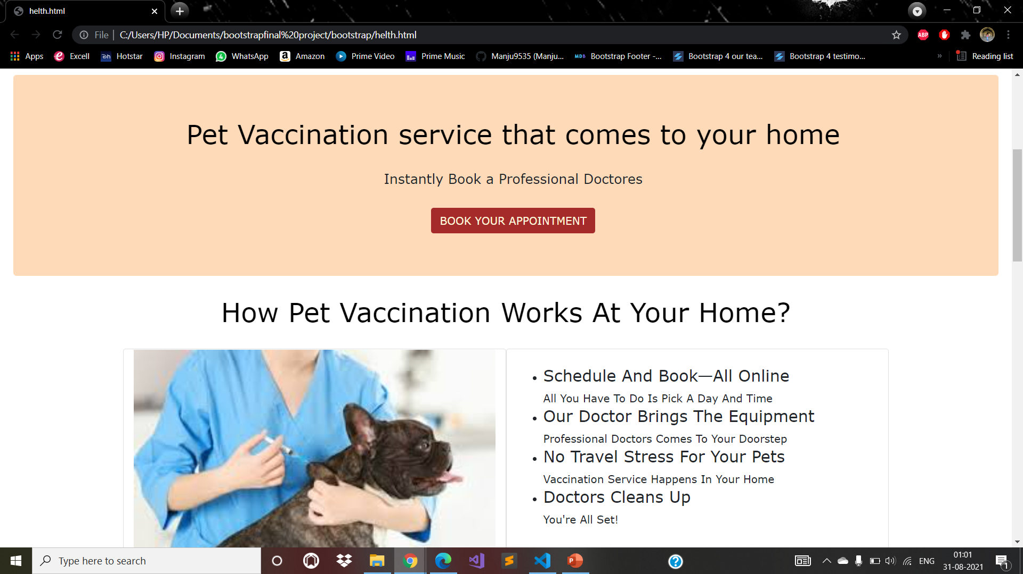
VACCINATION

Slide 26
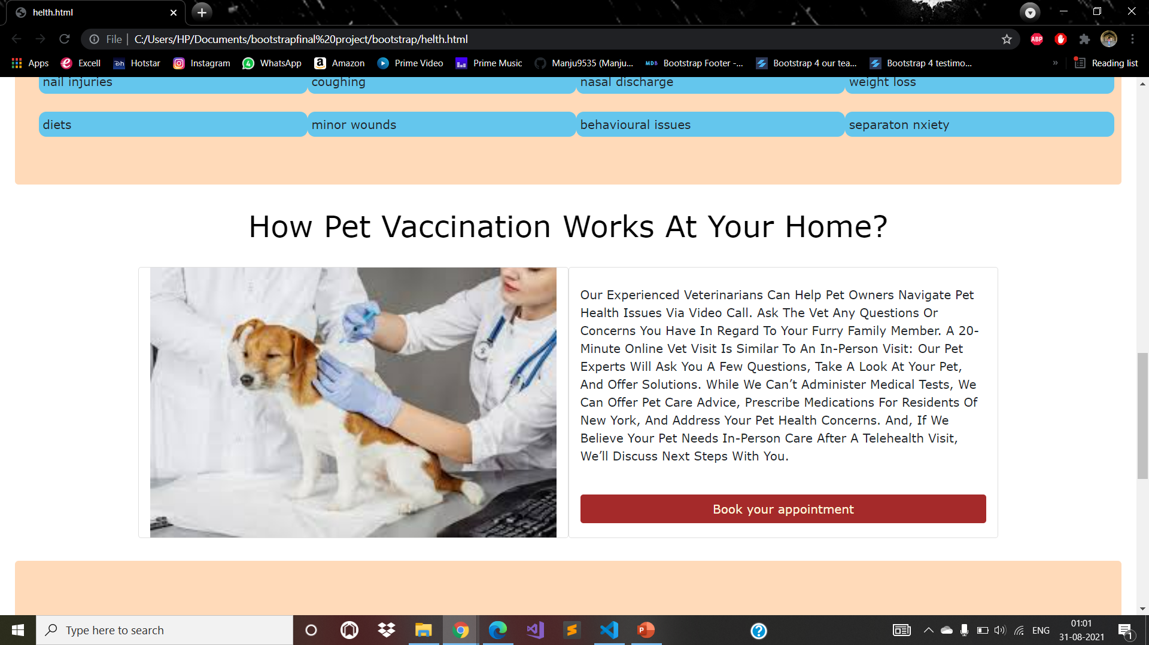
VACCINATION

Slide 27
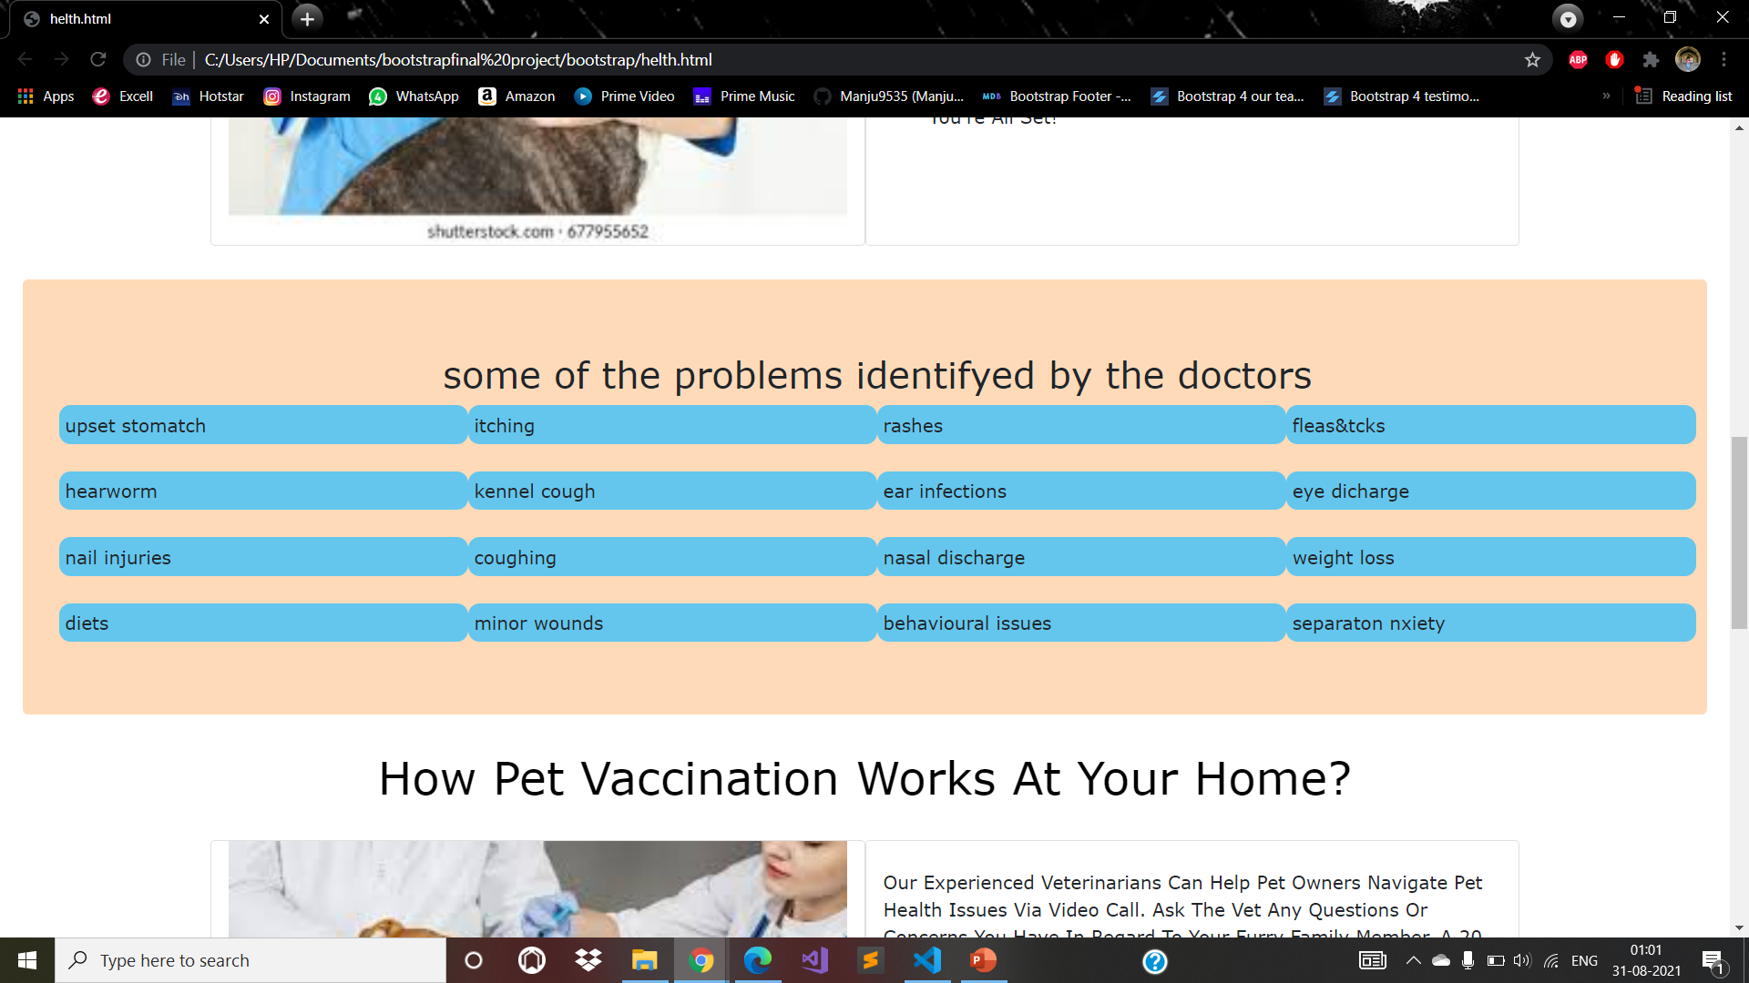
TELE-HEALTH

Slide 28
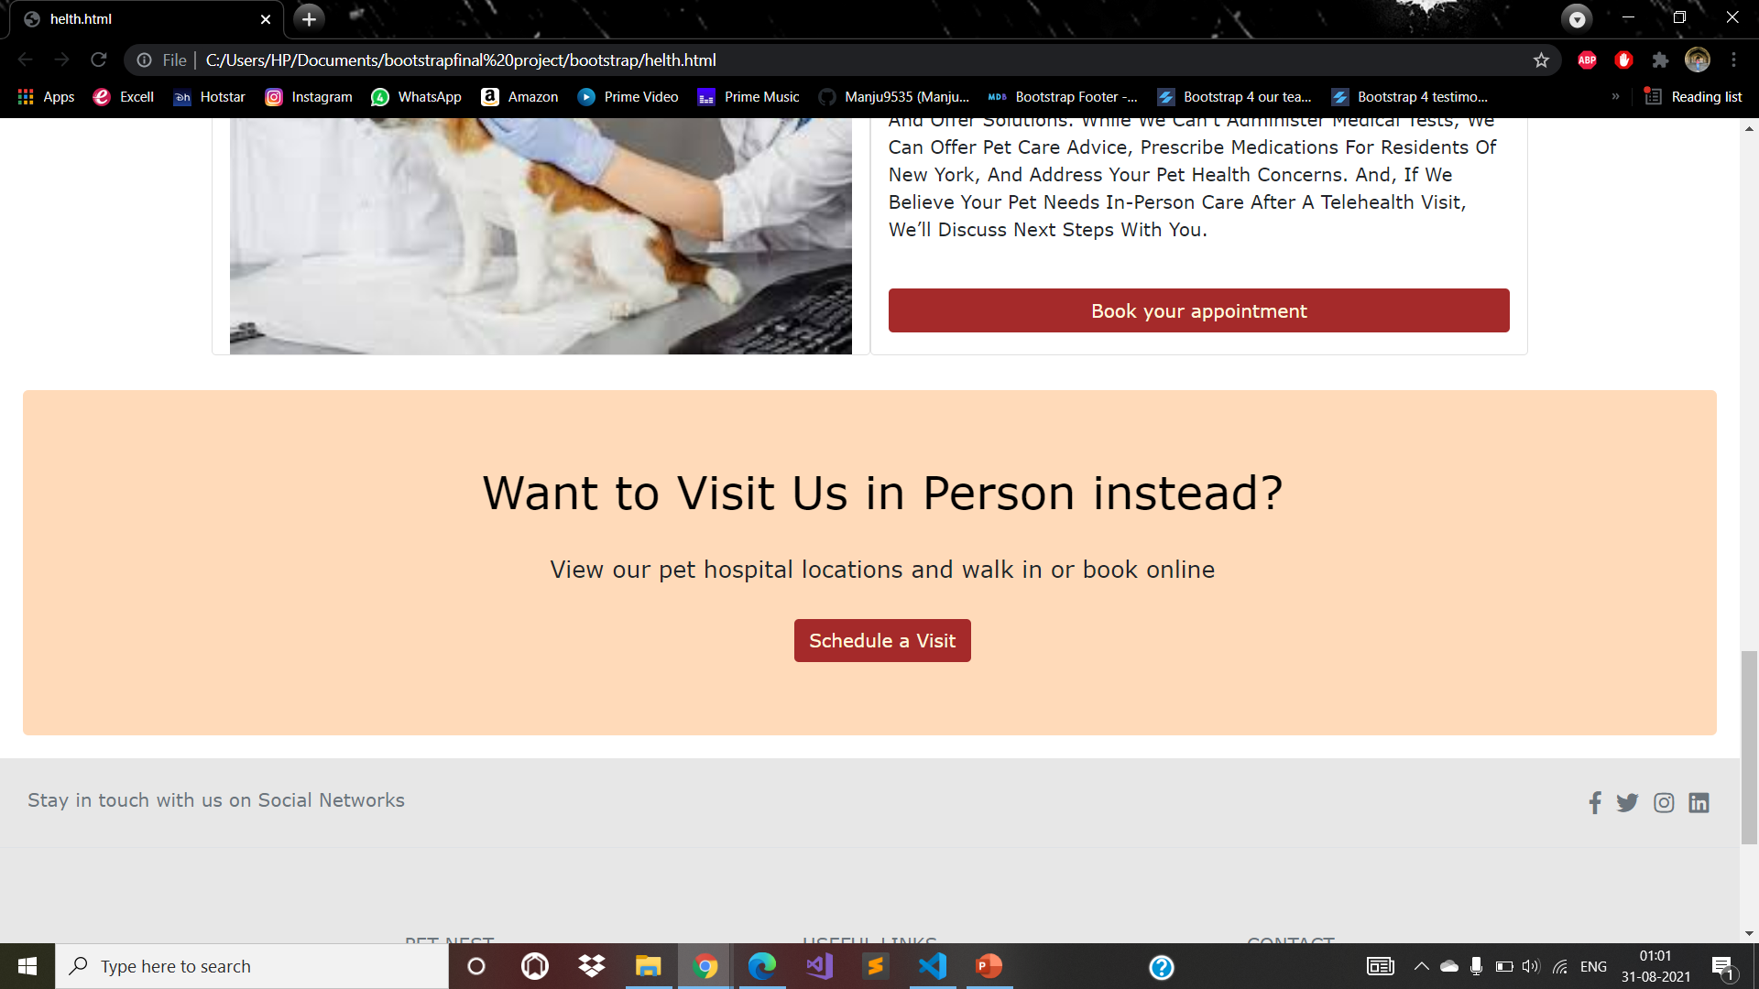
TELE-HEALTH

Slide 29
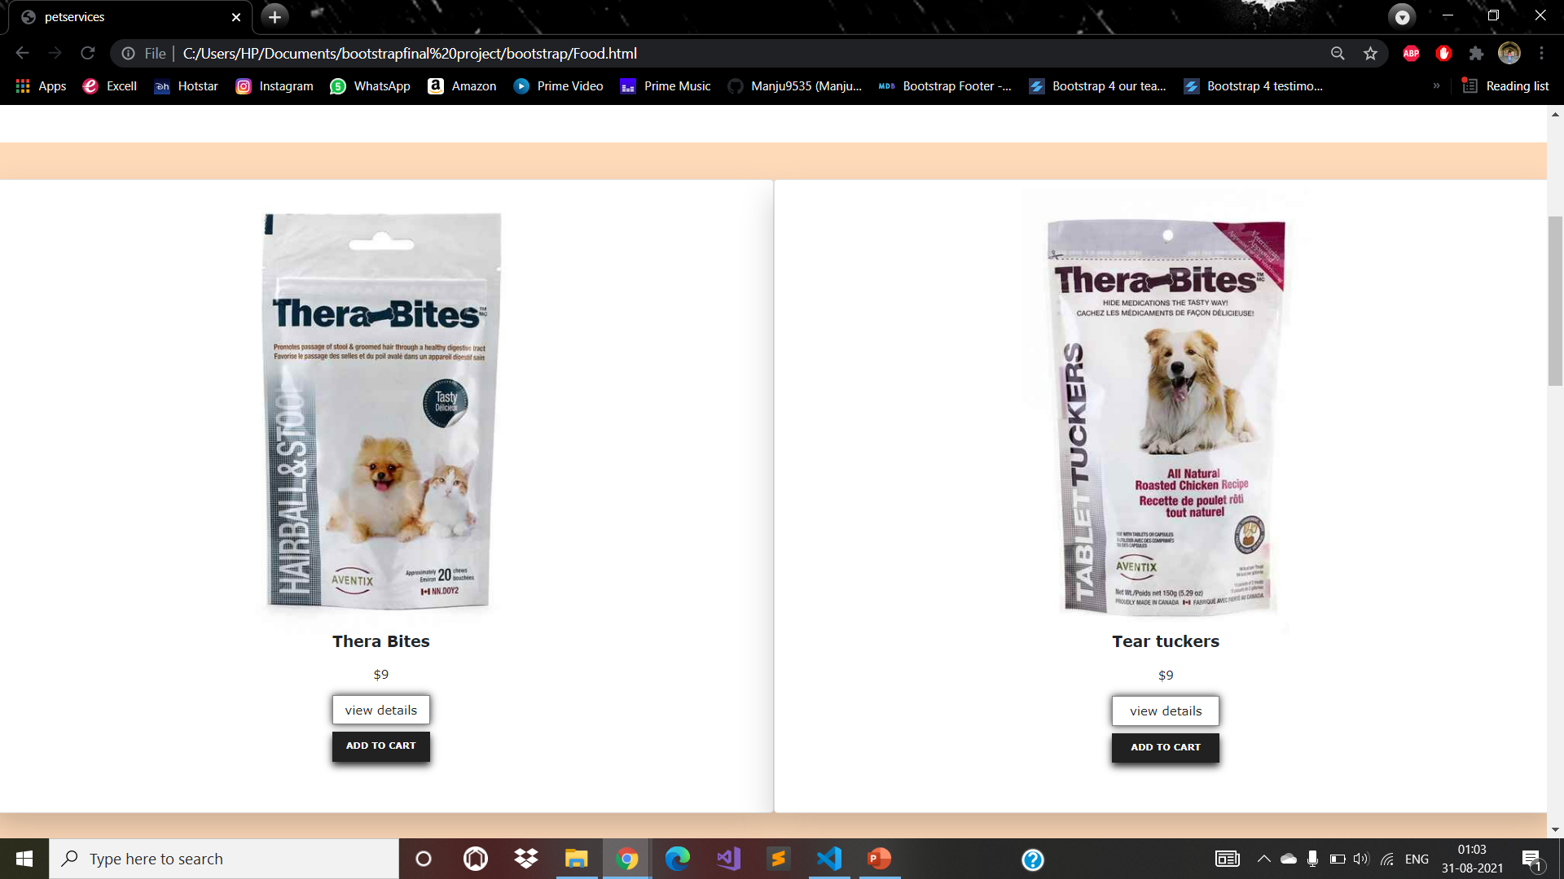
FOOD

Slide 30
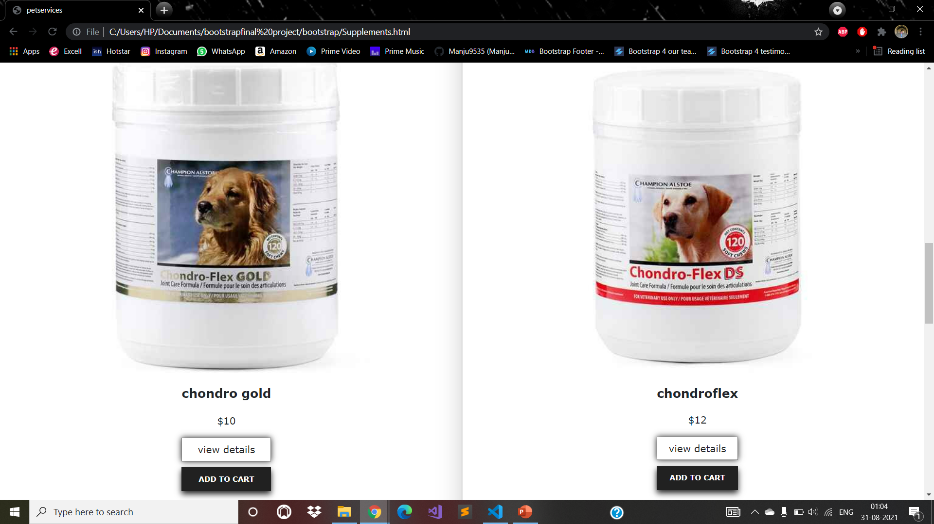
SUPPLEMENTS

Slide 31
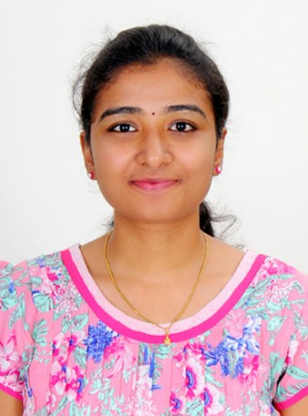
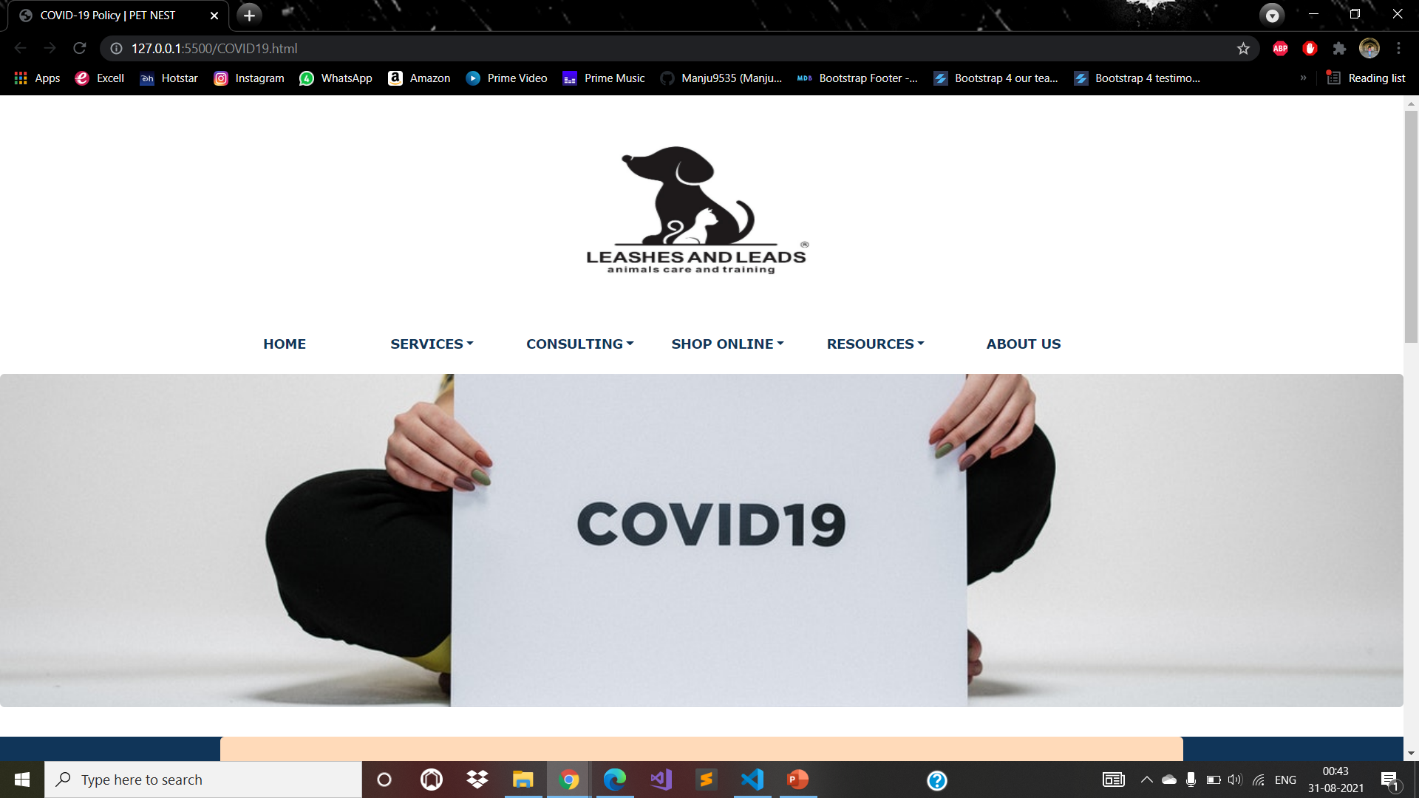
COVID19 POLICY

Slide 32
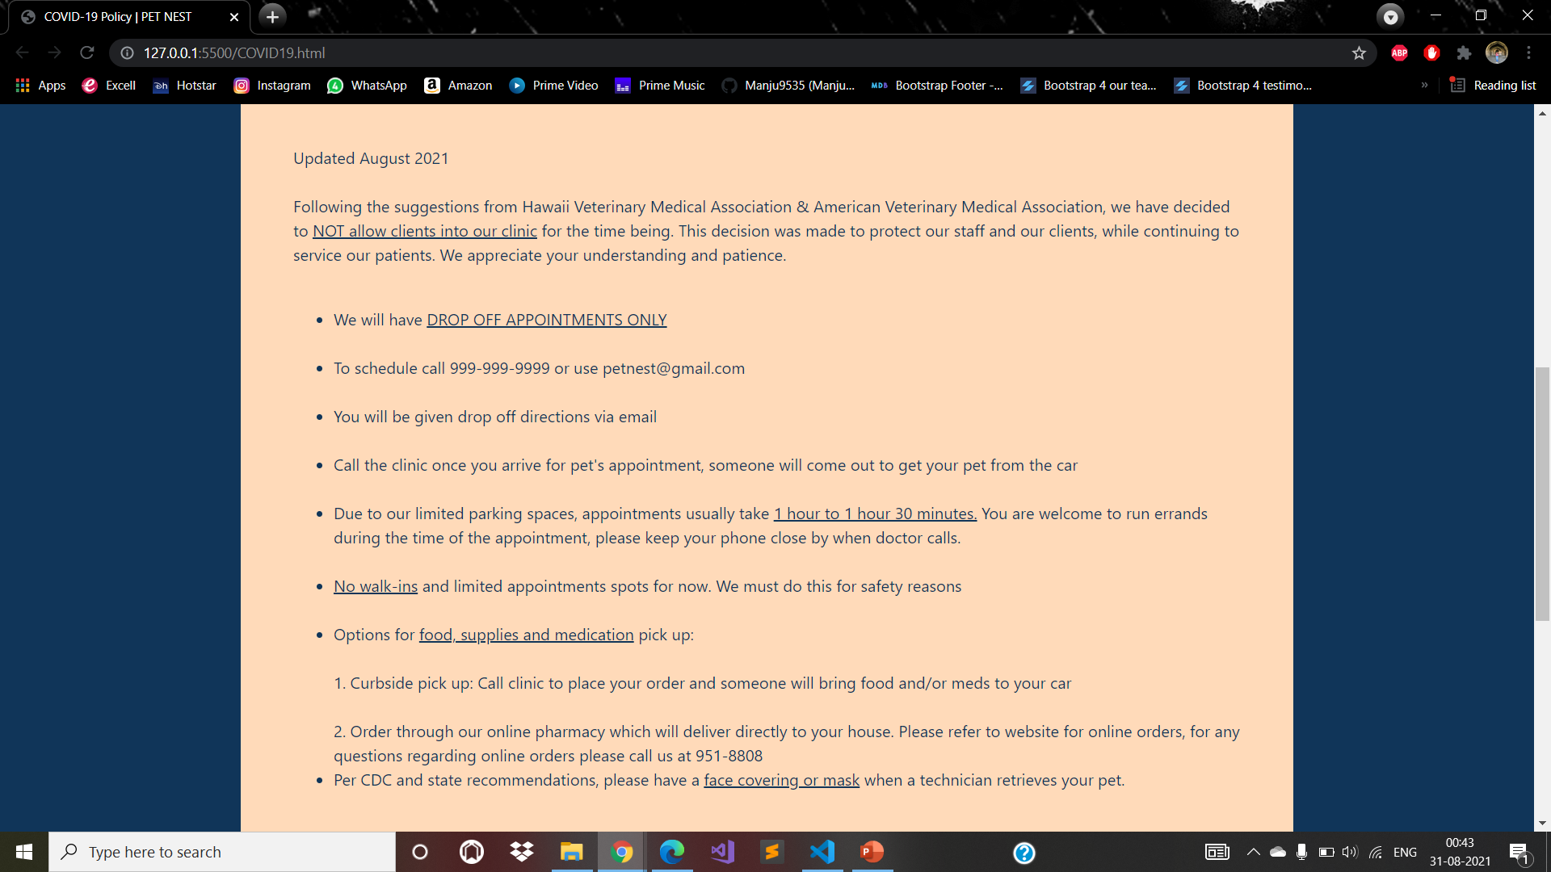
COVID19 POLICY

Slide 33
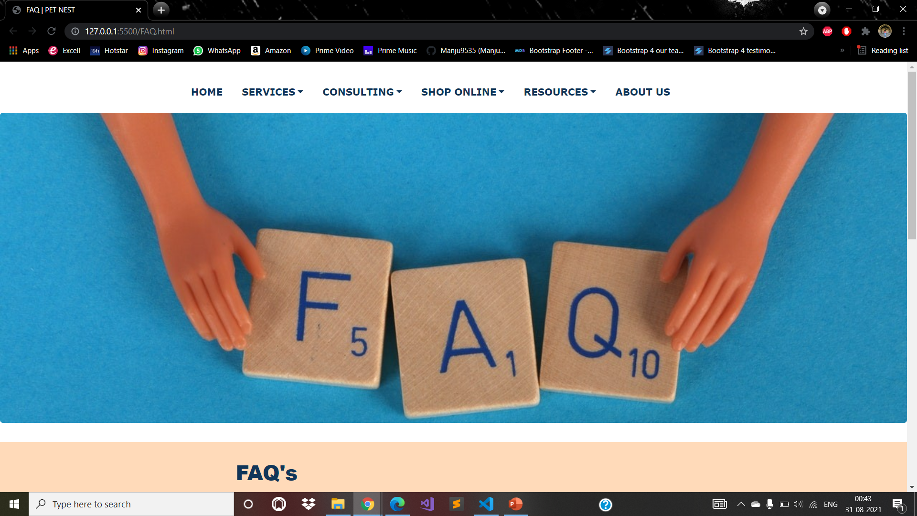
FAQ

Slide 34
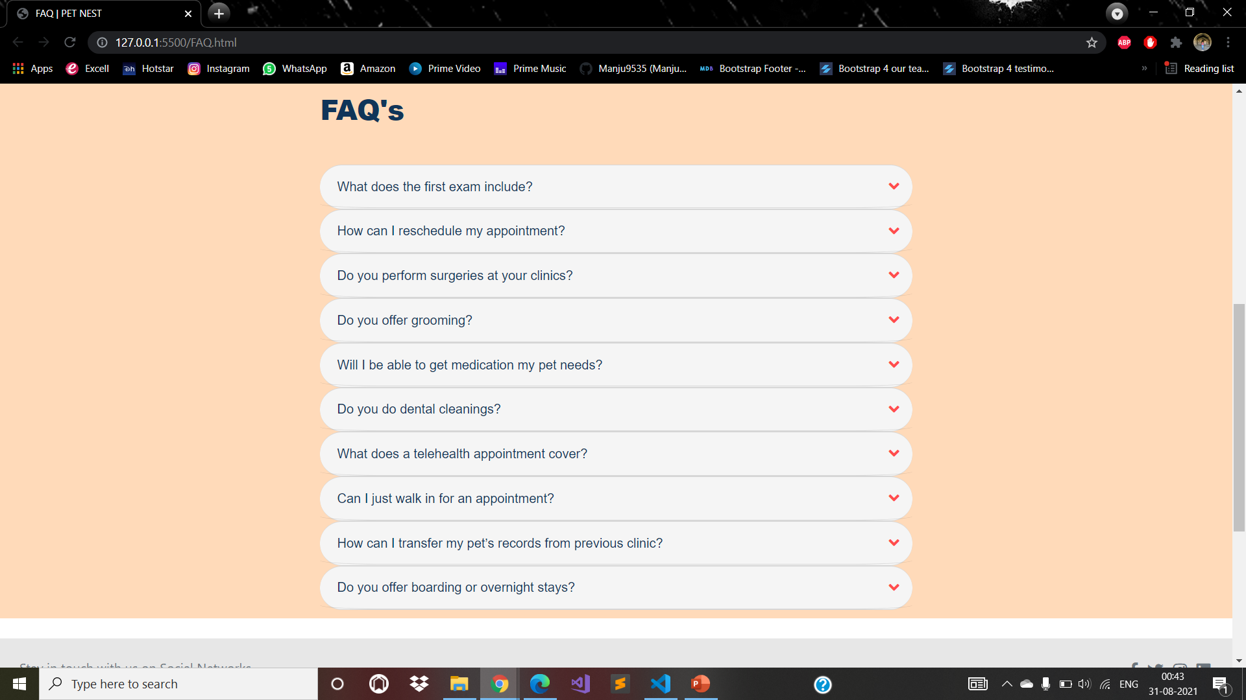
FAQ

Slide 35
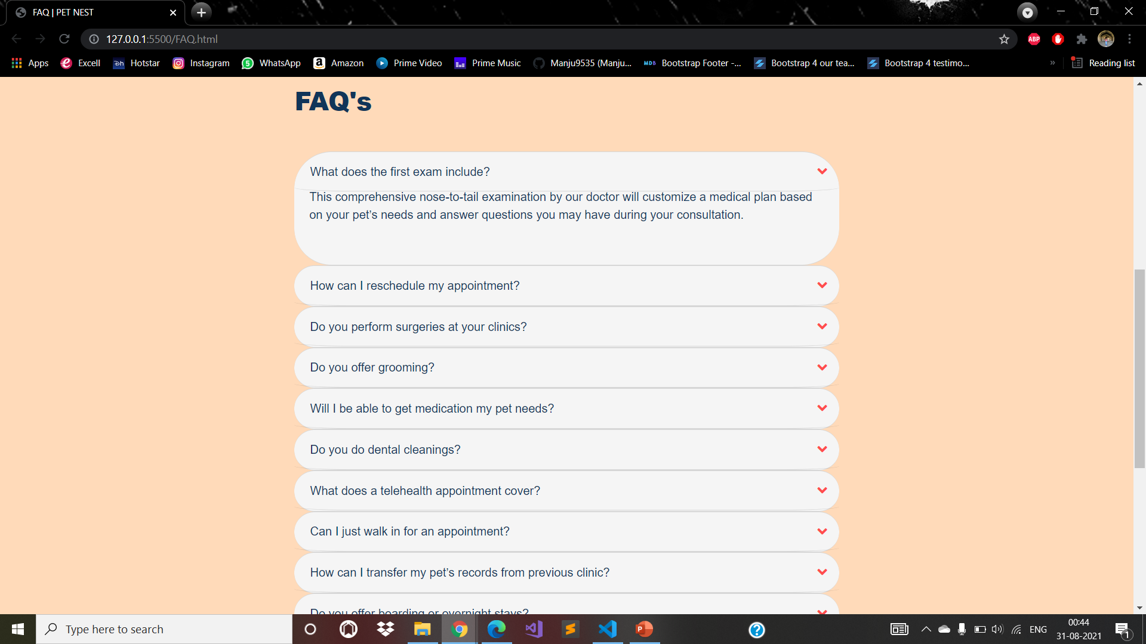
FAQ

Slide 36
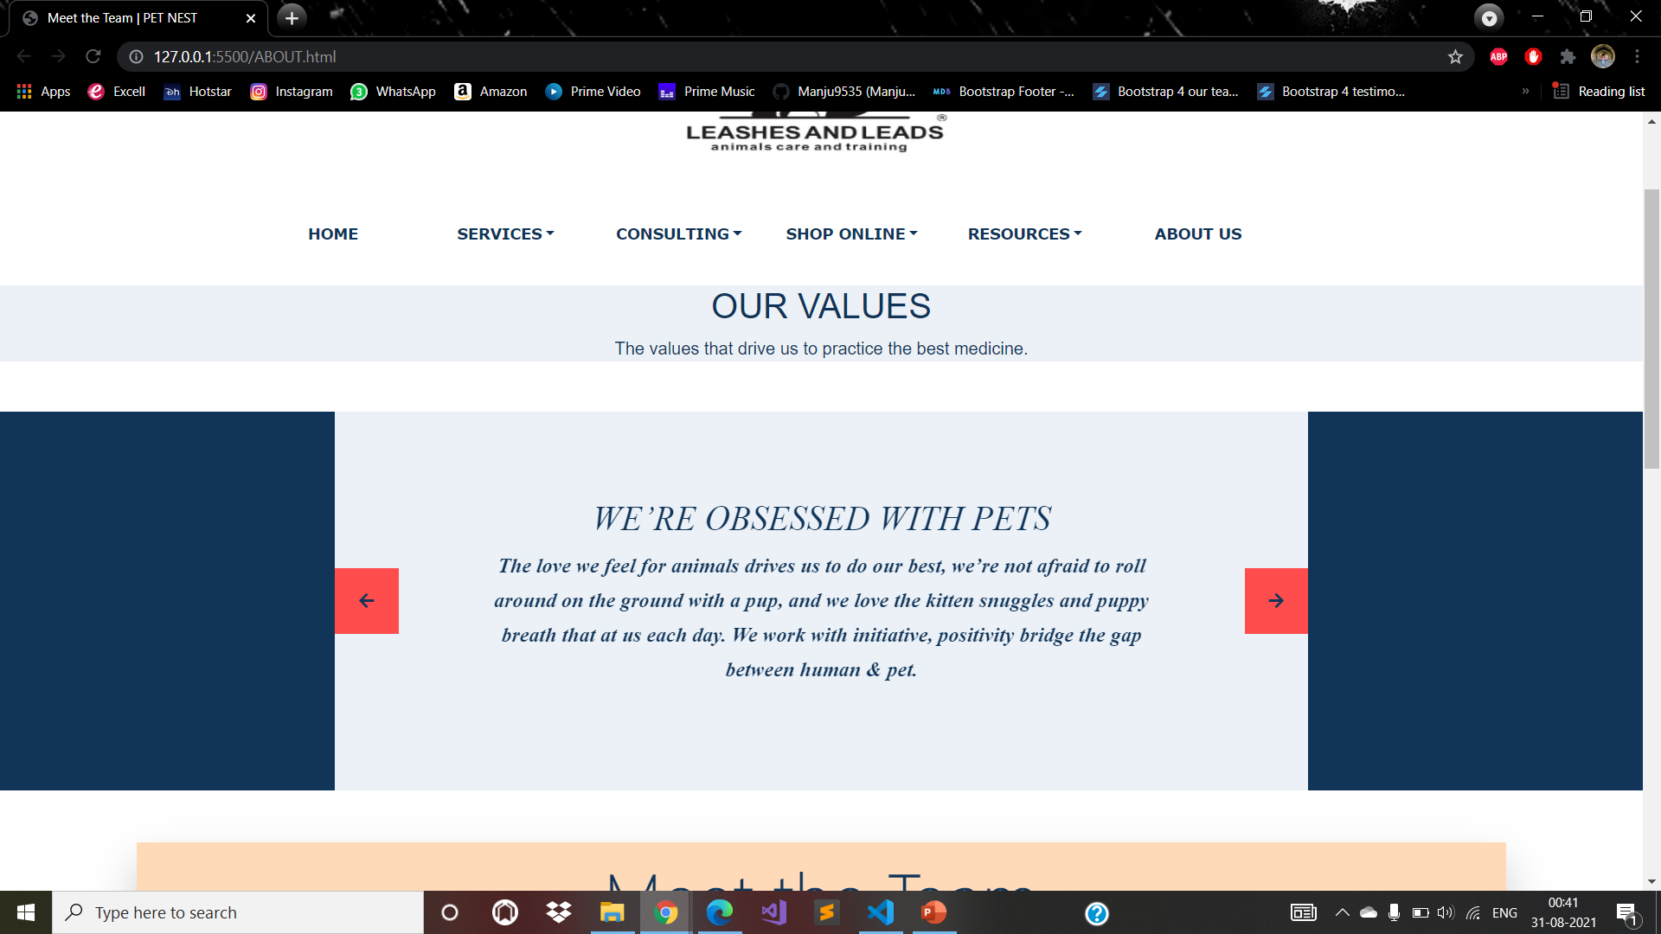
ABOUT US

Slide 37
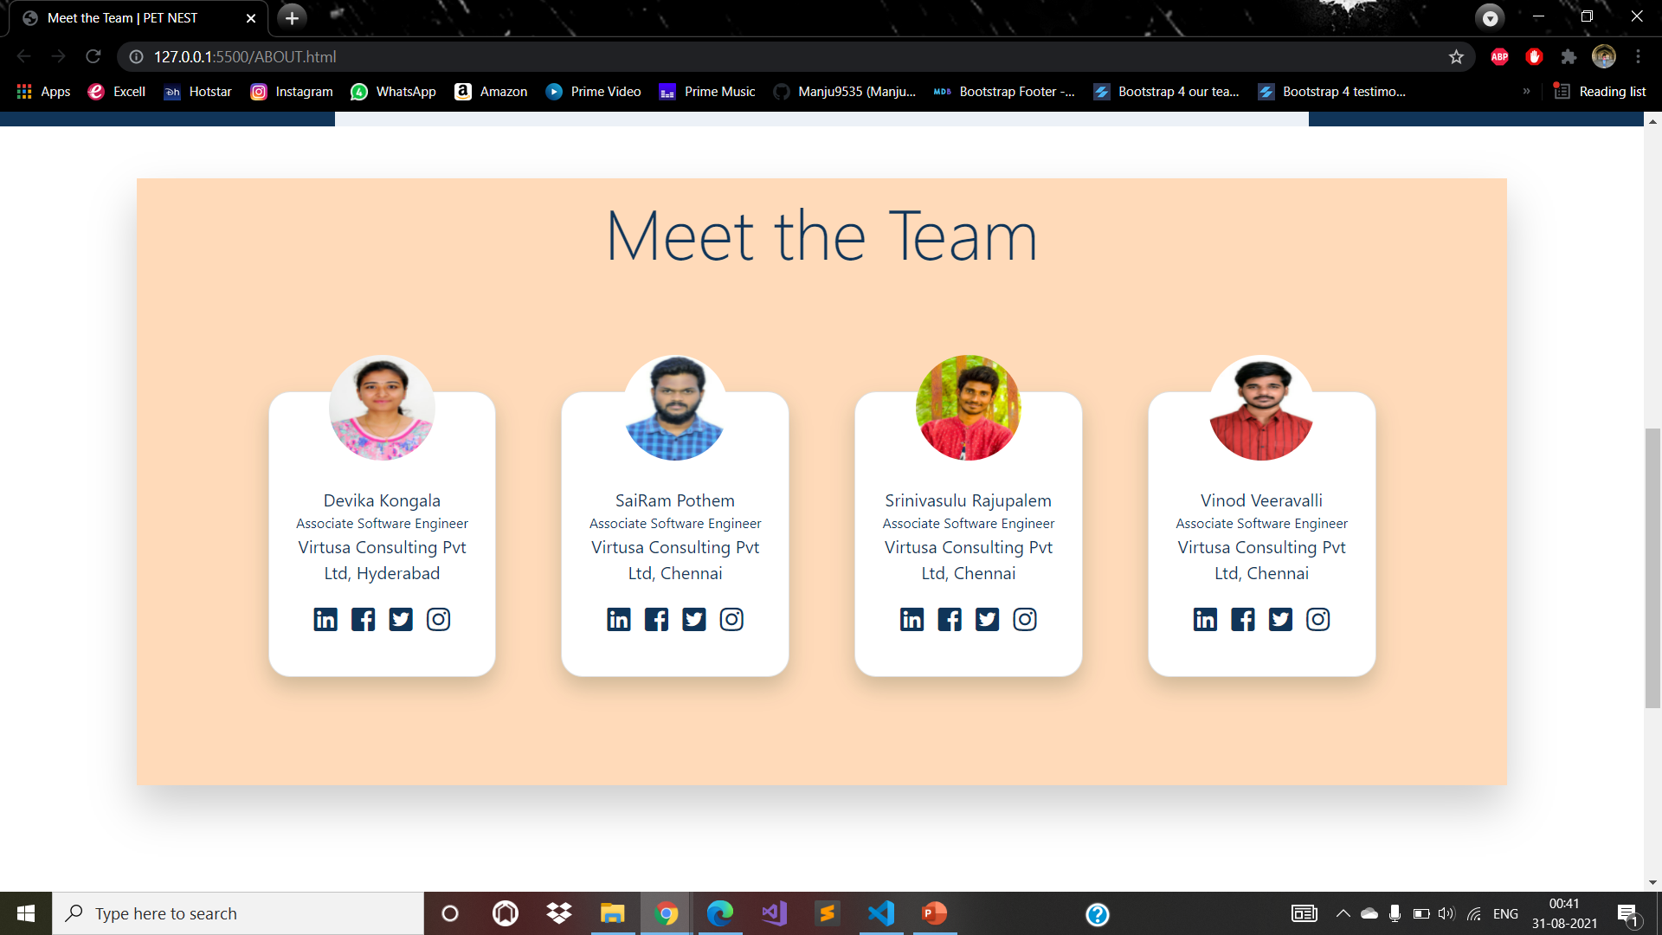
TEAM

Slide 38
THANK YOU.

